Slide 1
Testing Across the Stacks:
An Intro to Testing Both the UI and API Layers Together
Notes:
Solution running in chrome, Swagger open in a tab
Dev tools closed
Postman open and empty of todo collection
Browser tab open to string generator & Unicode snowman
ZoomIt running

Slide 2

Hello!
Hilary Weaver-Robb
Sr. Software Engineer in Test – Quicken Loans, Detroit MI USA

Slide 3
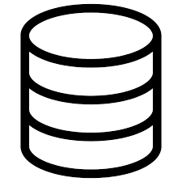


Full Stack Testing
Notes:
When I got started in testing almost 13 years ago now, I only learned about UI testing. I had no idea about testing anything else! I had a computer science degree, but we didn’t build giant applications, and we certainly didn’t talk about how to test them.
* But when I started to learn how to blur the lines between front-end testing and back-end testing, I realized I was learning so much more about the application I had been testing for a long time! I started to actually understand how things fit together, and find bugs before the UI was done, which was like a revelation to me. I could find bugs earlier in the process, and provide support for my application so much better because I became a subject matter expert

Slide 4
Objective
Level Setting on Definitions
Why test APIs?
HTTP Response Codes
Finding the API calls your UI is making
How familiar UI tests translate to API tests

Slide 5
Level Setting
API and Web Service Definitions
Notes:
First we’ll get a common understanding of these terms.

Slide 6
What is an API?
Application Programming Interface
What allows other programs to talk to a program
Notes:
Simply an API or Application Programming Interface, is what allows other programs to talk to a program

Slide 7
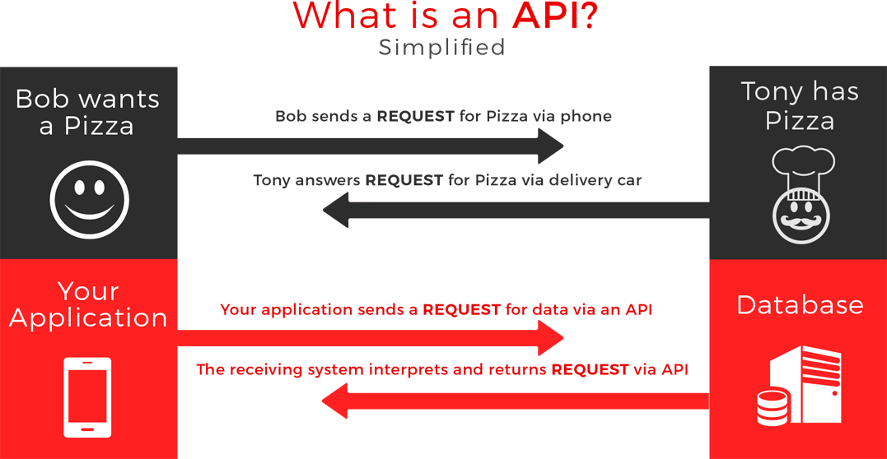
https://coresolutions.ca/images/blog/CoreSolutions-api-graphic.png
Notes:
I found this simple diagram that is pretty helpful in explaining an API. The colors are a bit off for me, but the explanation is good :D
(walk through the diagram)

Slide 8
What is an API?
APIs keep developers from having to reinvent the wheel
App that requires pinch-zoom
Interact with printers
Include Google Ads in your website
Use Facebook authentication
App that sends push notifications
App that has to validate street addresses
Notes:
Essentially, APIs help developers interact with each others code. And reuse code that someone else wrote.
*So that way I don’t have to know how to code the pinch-zoom in my app all the way down to the devices operating system code. I just have to know that operating system has an API that I can use for those operations.

Slide 9
What is a Web Service?
Web Service is machine-to-machine interaction over a network
A Web Service needs a network connection while an API may not
All Web Services are APIs but not all APIs are Web Services
Notes:
Web services are just types of APIs
They are machines talking to other machines, basically, over a network such as HTTP
Because it uses HTTP to communicate, web services need a network connection
All web services are APIs but not all APIs are web services

Slide 10
API vs Web Service
API but not Web Service
App that requires pinch-zoom
Web Service
Include Google Ads in your website
Interact with printers
App that sends push notifications
Use Facebook authentication
Interact with printers
App that has to validate street addresses
Notes:
Those APIs that we mentioned earlier may or may not be web services. Let’s take a look at them and talk about why.
** for the remainder of this workshop, we’ll be focusing on web services specifically. Note that I may use API and Web Service interchangeably during the workshop, but you all know that I mean web services. It’s just easier to say API sometimes :D

Slide 11
Types of Web Services
REST
SOAP
GraphQL
Notes:
There are a few types of web services we’ll see, but we’re going to be focusing on

Slide 12
Focus on REST Web Services
URL tells you what you’re working with and doing
Messages can be lightweight (even just the URL!)
Good basis for these concepts
Notes:
REST since they’re a bit easier to get through the concepts of. Once you get those, though, you understand the basis for all of them. Just know when you’re encountering and testing these web services, you should get to know what type it is so you can further explore those

Slide 13
CRUD
Create
POST
Read
Update
PUT
Delete
DELETE
GET
Notes:
One concept you need to know is CRUD, or Create, Read, Update, Delete.
Our CRUD operations (or Create, Read, Update, Delete) are handled by HTTP methods or sometimes referred to as verbs
For Creating data, our HTTP method is a POST
For reading or fetching data, our HTTP method is a GET
For Updating data, our HTTP method is a PUT
And for Deleting data, our HTTP method is a DELETE
There are other HTTP methods that are used, but these are the most common and most important for you to understand

Slide 14
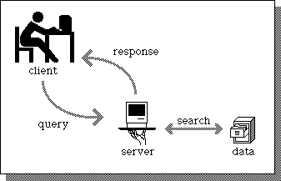

Client-Server
Client-Server architecture using HTTP protocol
Client sends Request to Server
Server sends Response back
Notes:
Another facet of web services and REST in particular is client-server architecture using HTTP protocol.
(explain)

Slide 15
Why Test APIs?

Slide 16
Why Test APIs?
HTML &
CSS
JavaScript
API
Backend
Notes:
You have this api, and no matter if it’s being consumed
* by your own user interface (with HTML & CSS and JavaScript) or

Slide 17

Why Test APIs?
Someone else’s code
API Client
API
Backend
Notes:
It’s consumed by somebody else’s code, or a simple API client like Postman, this is still code that needs to be tested!
And what about the people that turn off JavaScript? Are you validating people’s inputs just in the JavaScript or are you checking at the API level?
If someone turns off Javascript will they be able to get around requirements and break your api?

Slide 18
Why Test APIs?
Usually complete before UI is even started
Not everyone wants to use the UI!
Validate the ductwork
UI can pull in multiple APIs
Because it’s code!

Slide 19

https://dribbble.com/shots/4222448-Pancakes
Notes:
There are many layers to our applications, and we don’t want to ignore any of them! You want to make sure you’re testing a good ratio. You don’t want to ignore your UI for your web services, but you also don’t want to ignore your web services for your UI. Find the right ratios for your project!
Hopefully this talk will help you to think about how you can test your application differently, and maybe more effectively

Slide 20
HTTP Response Codes and How They Fit

Slide 21
HTTP Response Codes
Indicate if HTTP request is successful or not
Informational (100s)
Successful (200s)
Redirects (300s)
Client Errors (400s)
Server Errors (500s)
Notes:
HTTP response codes tell us if we made a request properly or not, or if the web service can handle what we requested.
These are especially useful in our testing because this is how we can understand how the web service was written.
We may even expect a different response code than what we received for a specific test, which can also be a bug.
There are about 70 response codes total, but they fall into these categories

Slide 22
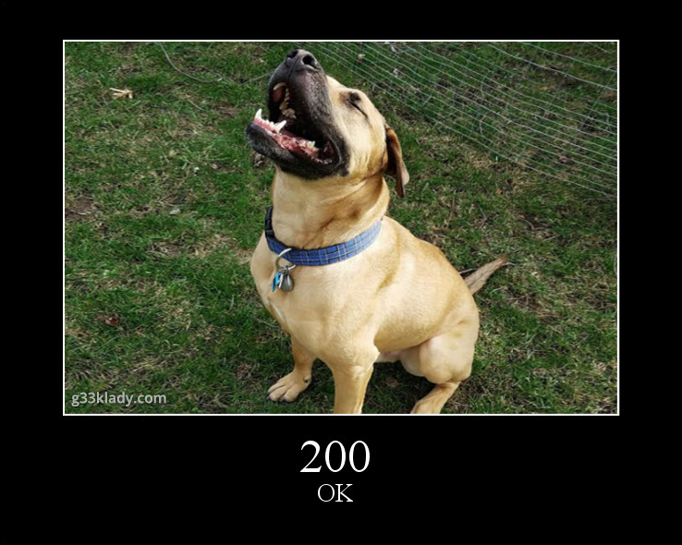
Common HTTP Response Codes
Successful Codes (200s)
200 OK
201 Created
204 No Content
Notes:
If you google http response codes, you’ll most likely run across the HTTP Status Cats, which is basically pictures of cats to represent each of the status codes. I decided to do the same thing, but with my dog. So you’ll see more of him :D
So for the Success codes, or 200 levels, the most commonly found ones are
200 ok – everything is ok, nothing to do
201 created – you asked us to create something, and we did without error
204 no content – we did what you asked, but didn’t need to send any response other than the code

Slide 23
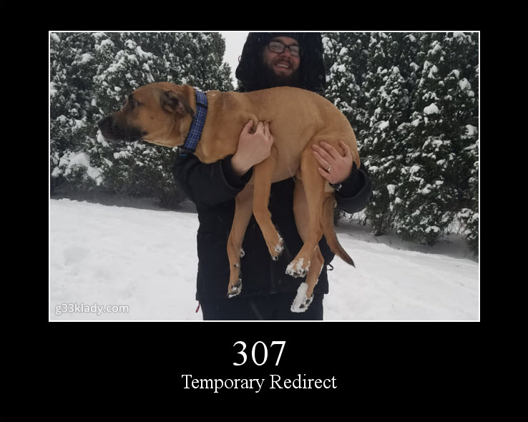
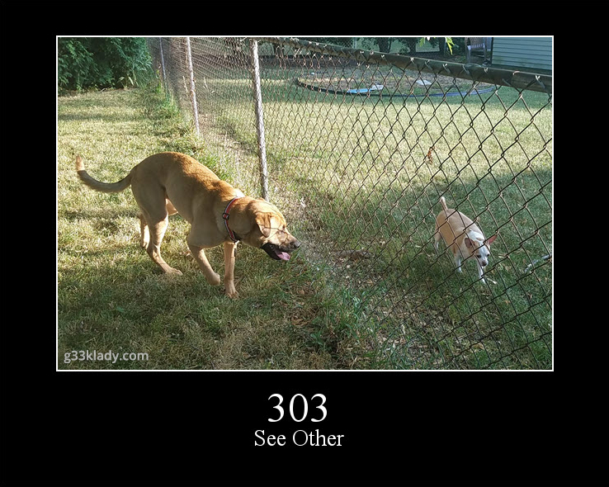
Common HTTP Response Codes
Redirection Codes
303 See Other
307 Temporary Redirect
Notes:
For the redirection codes, we have
303 See Other – generally, you tried to get something from this resource, but it’s available under a different URL
307 temporary redirect – the resource you want is temporarily moved to another URL

Slide 24
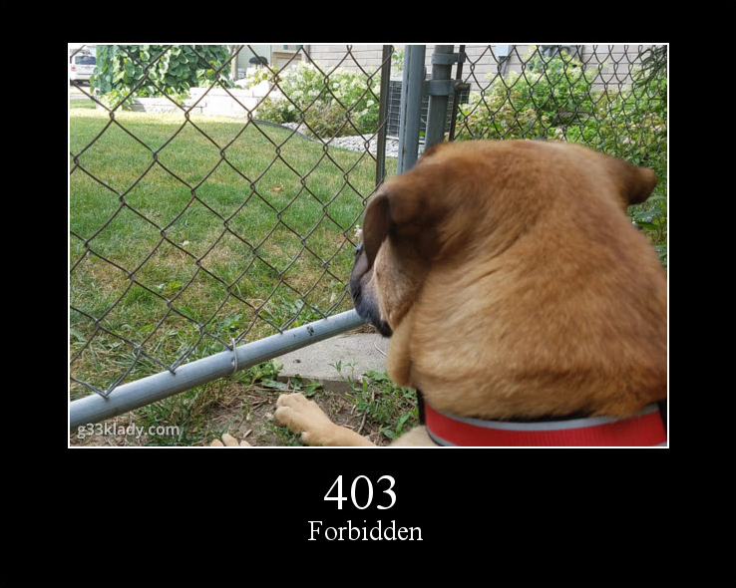
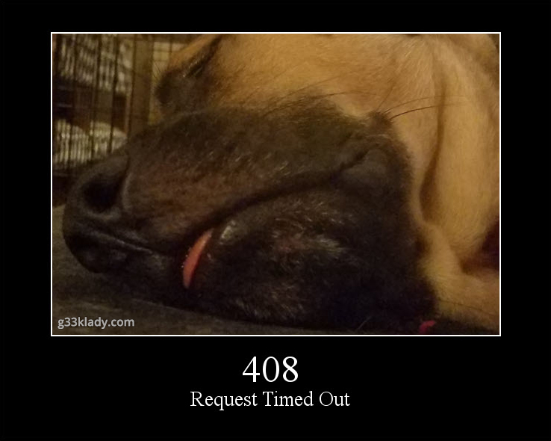
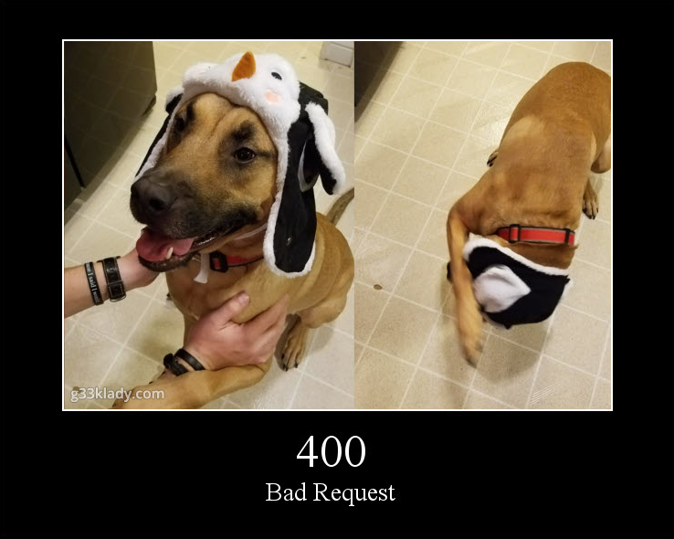
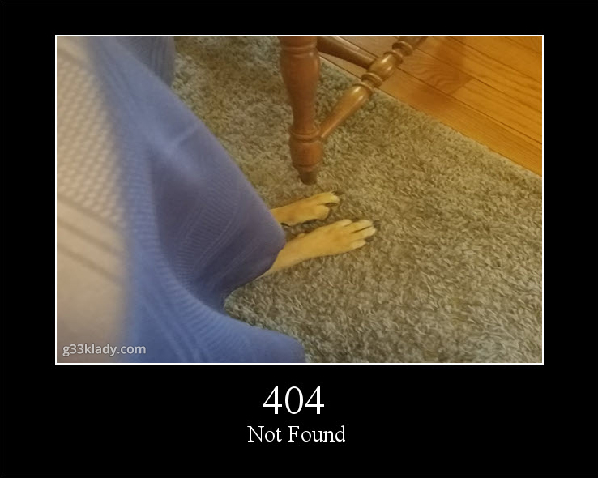
Common HTTP Response Codes
Client Error Codes
400 Bad Request
401 Unauthorized
403 Forbidden
404 Not Found
408 Request Timed Out
Notes:
The Client error codes – where your request isn’t quite right for a number of reasons
400 bad request – generally bad syntax here – the request itself is malformed
401 unauthorized – the request requires you to send authentication information
403 forbidden – server refuses to fulfill the request, and authentication/authorization won’t help you. Basically stop trying to do whatever you’re doing
404 not found – we’ve all seen these. The thing you’re looking for isn’t here or doesn’t exist
408 request timed out – server timed out waiting for the request, repeat the request and see what happens

Slide 25
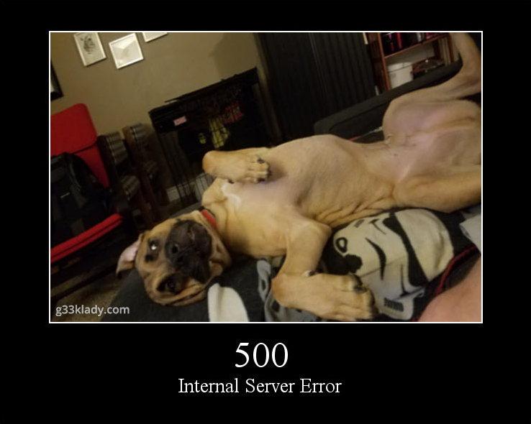
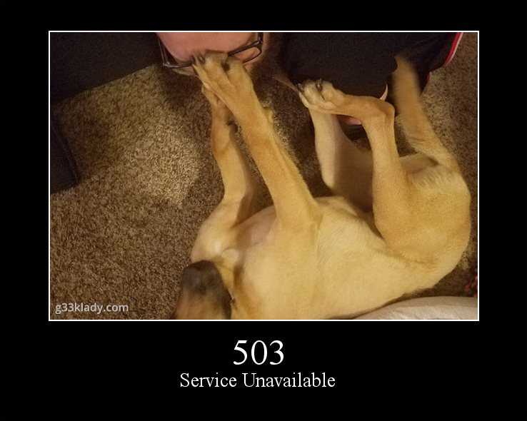
Common HTTP Response Codes
Server Error Codes
500 Internal Server Error
503 Service Unavailable
Notes:
And then the server error codes – these are ones where either it was a totally unforeseen circumstance, or the application is not coded to handle these scenarios
500 internal server error – generic catch-all error when the server throws an exception
503 service unavailable – the server is temporarily unavailable, either due to maintenance or it’s been overloaded

Slide 26
How Can We Test APIs?

Slide 27
How Can We Test APIs?
Manual Testing Tools
Postman
Fiddler
Advanced REST Client
ReadyAPI (SoapUI)
Swagger
Insomnia
Command line
Browser Dev Tools
Automation Tools
Postman
ReadyAPI
Most unit testing frameworks
Notes:
There are a lot of tools out there now to test web services and APIs – there’s the manual testing tools such as <list>
And a lot of automation tools as well
Ones we’ll focus on using today is Browser Dev Tools and Postman. We’re going to just skim the surface with these tools so please take the opportunity to dig into them – they’re free to use and have lots of great features!

Slide 28
Why Do We Need These Tools?
We need some form of interface
Act as the client
Make the request
Receive the response
Handle headers/cookies/etc
Not all APIs have a UI function correlated
Notes:
We need these types of tools to test APIs because
APIs need some form of interface for us to test them.
You need some kind of client,
You need to be able to make the request and deal with the HTTP protocols
You need something to receive the response and interpret it properly
And something to handle headers, cookies, and everything else that goes along with it
And not all APIs can be tested via the UI. There are some APIs that have no UI component at all, whether there’s a website using that API or not

Slide 29
What Types of Tests Can We Perform?
Smoke tests
CRUD
Boundary
Required Fields
Field Type
Error Conditions
Security
Performance/load/stress
Usability
Localization
Consumer-Driven Contract
Many more!
Notes:
The types of tests we can perform on an API are mostly the same as on a regular user interface!
Yes, even Usability testing – someone or something is consuming your API, so it should be usable!
We’ll look at how some of our common tests in the UI translate to tests against the API in a little bit

Slide 30
What to Test?

Slide 31
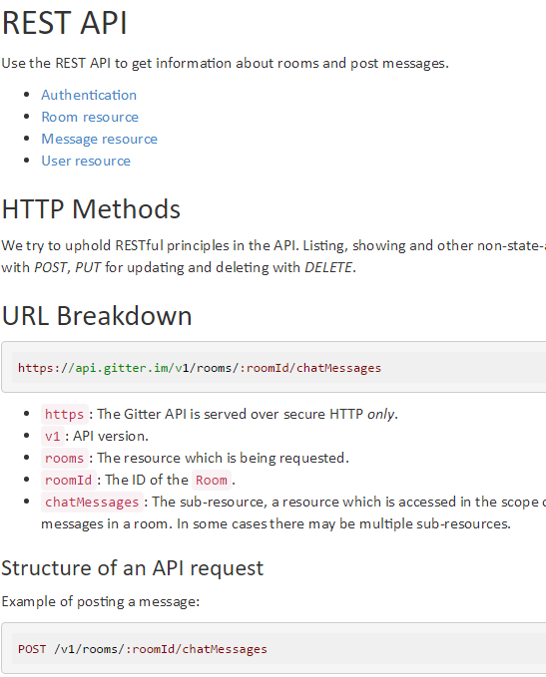
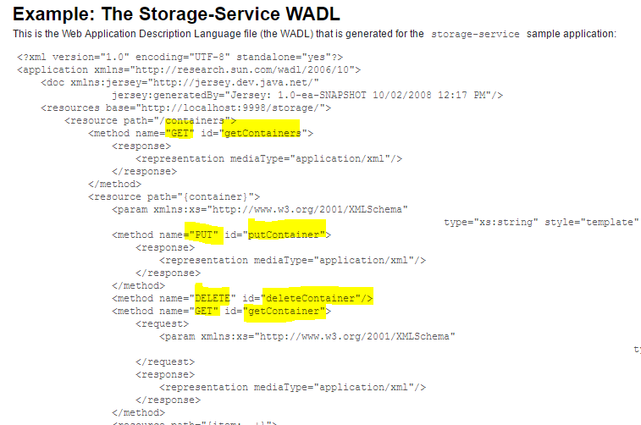
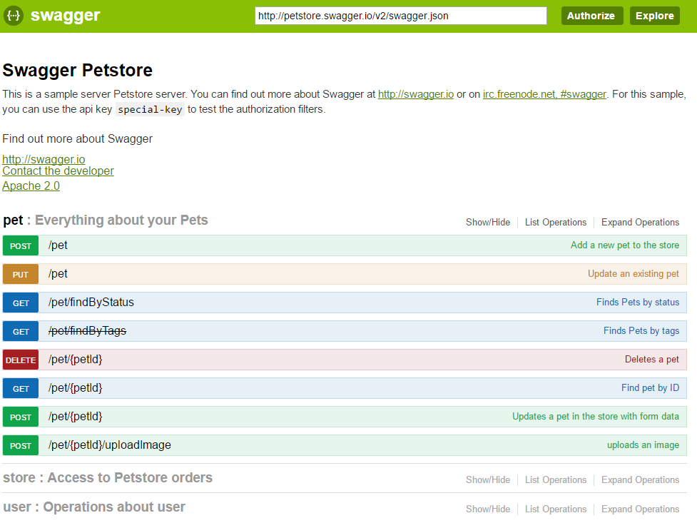
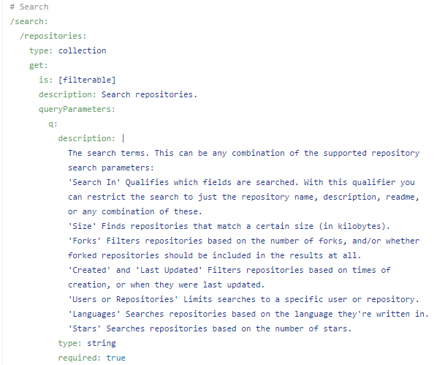
How Can I Figure Out What to Test?
Documentation
Swagger/OpenAPI
WADL/WSDL
RAML (RESTful API Modeling Language)
Notes:
There’s all kinds of ways we can learn about our API and start figuring out how to test it. It’s all essentially some kind of documentation, just in different forms
* Lets look at the OpenAPI documentation for an application we’ll be digging into today ((switch to Swagger))

Slide 32
How Can I Figure Out What to Test?
Check out the code
Controllers
Models
Tests
Notes:
We can also learn about what to test by looking at our code.
The controllers tell the API what to do, how to route the calls that it receives
Models tell the API what the data it should accept or send looks like
And if there are any tests – unit tests or integration tests – those can help us to figure out how things should work as well, and how to test it
** optionally demo reviewing the controllers etc

Slide 33
How is The UI Using The API?
Notes:
So we know more about the API now, but how is our UI using the API?
What does this information in the docs really mean and how does that translate to how the application is actually used?

Slide 34
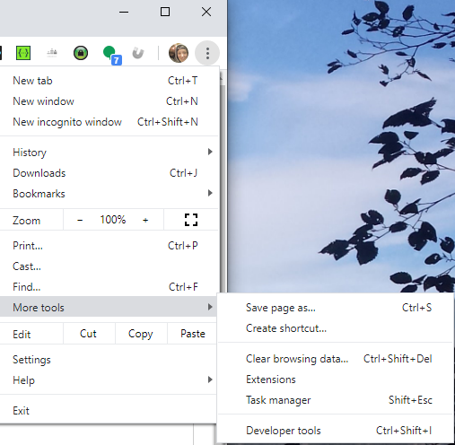
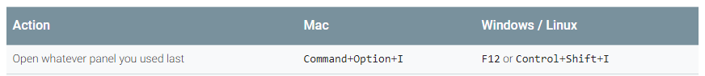
Dev Tools
Notes:
In most browsers, these commands will bring up the dev tools, or use the options in the browser
We’re going to be using Chrome for this talk, so we have a common baseline but I encourage you to check out dev tools in all of the browsers, and look for extensions to them as well to help improve your testing even more!

Slide 35
Demo
Network tab in Dev Tools
How the API is used when
Loading the page
Creating a new item
Editing an item
Deleting an item
Notes:
Show network tab and how to get there
Indication of status code
Request types
Header info
Request payload
Preview/response

Slide 36
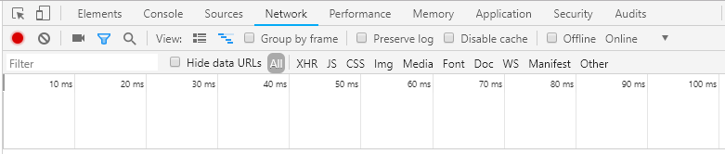
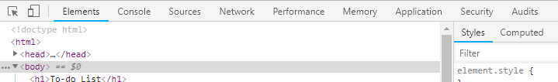
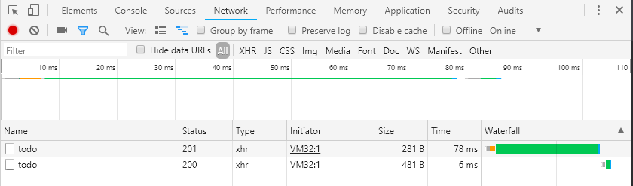
Network Tab
Notes:
The Network tab is where

Slide 37
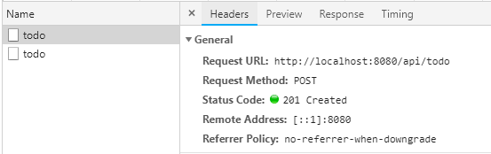
Network Tab
Notes:
We can see the
* Request URL
* The request method, in this case a POST because we were creating the todo item
* And the status code for the response. 201 created means it created just fine, no issues.

Slide 38
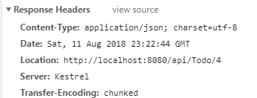
Network Tab
Notes:
The second section of the Headers, are the response headers
The most interesting part here for us is the Location
* Which shows the location of our newly created Todo Item. So if we did a GET request with this URL, we’d get our new todo item. This shows us the ID of our new item is 4

Slide 39
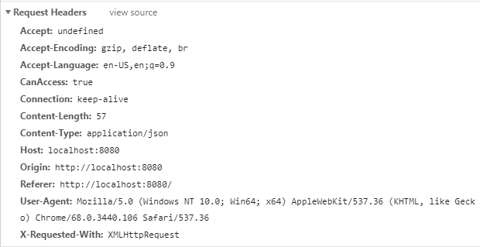
Network Tab
Notes:
The third section is our Request Headers, or what was added to the request automatically when it was made.
* Note we have our CanAccess header, like we added in Swagger. That’s added for us from the UI code
* The Host, origin, and referrer can help us track down where the request came from. Our API could limit calls from certain domains, for instance

Slide 40
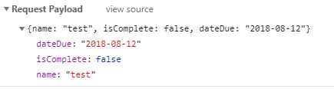
Network Tab
Notes:
The last section is our Request Payload, or the request body that was sent.
* We can see the actual JSON that was sent here
* As well as a parsed view of the data

Slide 41
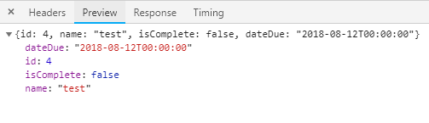
Network Tab
Notes:
We can see what the actual response looks like in a nicely formatted way from
* the Preview tab
* We can see the full unformatted response body
* As well as a nicely parsed and formatted response body
We can see that again, the item we just created has an ID of 4, so we can access it that way if we hit the API directly

Slide 42
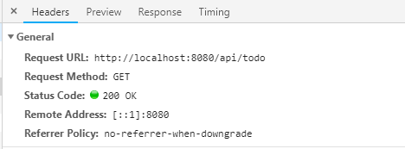
Network Tab
Notes:
Let’s check out the second request now
This is the webpage saying “after a new item is created, let’s pull the latest list of all of the items”
So this is a
* GET request, and the URL shows
* there’s no ID indicated here, so it’s a get of all items
* And the response is 200 OK, it didn’t have any problems getting the list of todo items

Slide 43
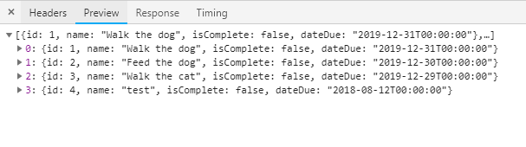
Network Tab
Notes:
And the response to the GET of all of the items, on the Preview tab it’s organized a bit nicer
So we can see all of our items and their ids from here

Slide 44
Observations
Some operations need an ID
Swagger and API inconsistent
One operation is in the Swagger but UI doesn’t use it
Notes:
What did you learn about the API and how the UI uses it? (should be a 10 minute or so discussion)
Some operations need an ID - The ID is used in the PUT and DELETE
Our documentation in Swagger has some incorrect information – the PUT has no response body but it says “returns the updated todo item”. The swagger is generated from comments in the code, not the code itself, so it isn’t infallible
We have one operation in the Swagger but it’s not used in the UI at all – the GET of a single Todo item

Slide 45
Notes
All browsers have dev tools
Other web proxy tools exist
Not all API calls are made via the UI
Notes:
Just some quick notes to keep in mind
* All browsers have dev tools. Some have more features than others. Most browsers also have extensions to make the dev tools more powerful, as well
* There are other web proxy tools available, not just the dev tools in your browser. Tools such as Fiddler, Charles Proxy, Wireshark. That way, you don’t need a browser to see what your application is doing. If it’s making calls to an API over HTTP, these proxy tools will see it
* And note that not all API calls are made from the UI directly. This application is a simple example, but a lot of applications have a middle layer that does all of that work, and you won’t see the calls it’s making to the API. So some applications, dev tools won’t work for you at all.

Slide 46
Testing with Postman
Notes:
Again, Postman is a tool for testing and developing APIs.
And a reminder we’re just going to scratch the surface of using Postman to test our APIs so please explore on your own.

Slide 47
Postman
“collaboration platform for API development”
API client
Free!
Notes:
Postman is, by their definition
A collaboration platform for API development”
It’s an Api client that we can use for our testing, it has a lot of great features that make API testing easier
And it’s free
It’s pretty commonly used, so we’ll be using it today. A lot of what you’ll see are available in other tools as well, but I use Postman the most so that’s what I’ll use here!

Slide 48
Demo
Getting requests into Postman
Copy from dev tools
Import from Swagger/OpenAPI
Reviewing requests in Postman
Notes:
Copy xhr as curl – paste code into postman for single request
Go to swagger and import from URL
Review how a GET and POST request looks in Postman
Method
url
headers
Request body
Make a simple get request
Review response
Response code
Response body
headers

Slide 49
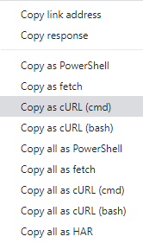
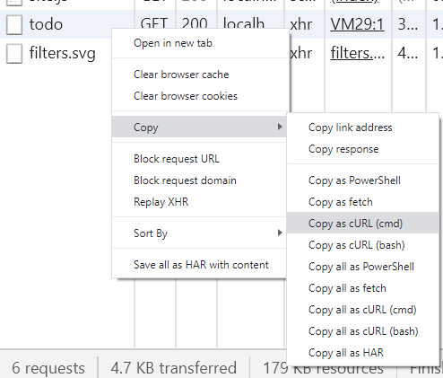
Add Requests from Dev Tools
Notes:
If there’s just a single request we want to test with in Postman, we can use the Copy feature in dev tool to copy the request
Right-click or cmd-click on the request in dev tools and select
Copy then
Copy as cURL (cmd). As you can see, you can copy those requests to use in a number of tools

Slide 50
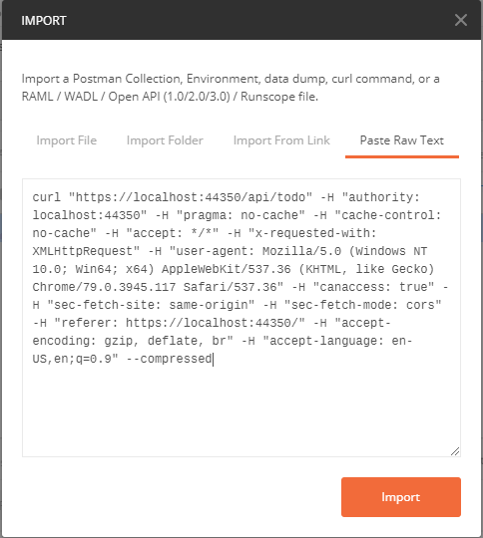
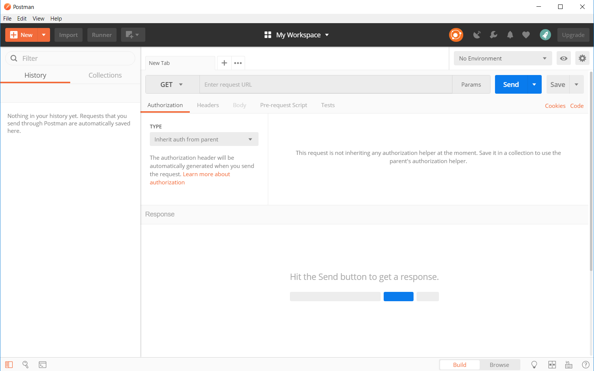
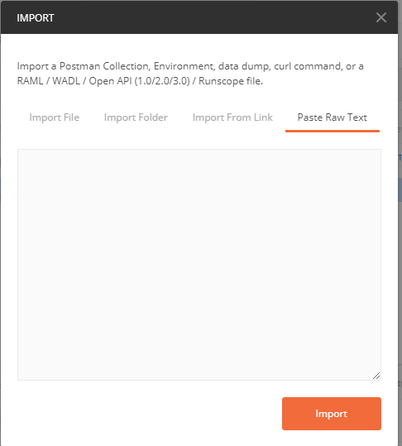
Add Requests from Dev Tools

Slide 51
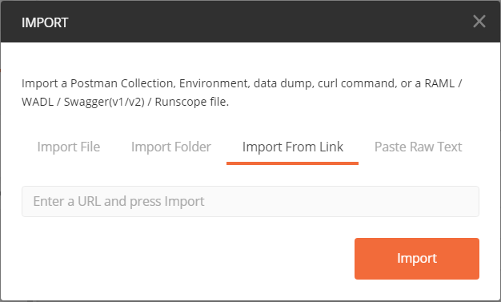
Create Our Collection
Notes:
There is a feature to import an API based on the Swagger, which will help us get up and running faster.
Go ahead and click Import, then
* choose Import From Link,

Slide 52

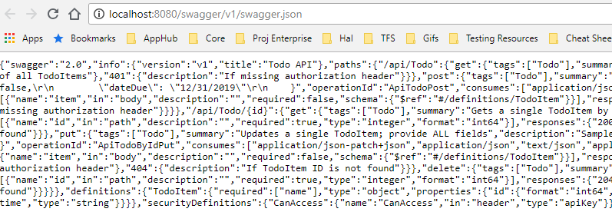
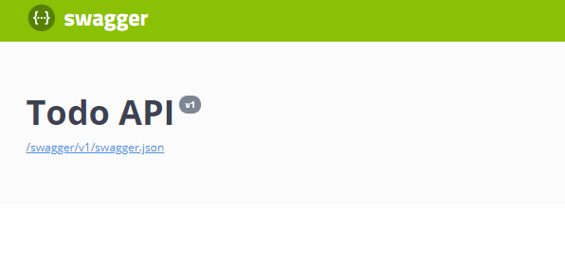
Create Our Collection
Notes:
Now we need to go to our site, to the swagger (remember we just need to put swagger at the end of the url to get there)
And click on this link underneath the title
* That will give us this page that has JSON on it, but we just need the URL so copy that
* And paste it into the Import From Link space, and click Import

Slide 53
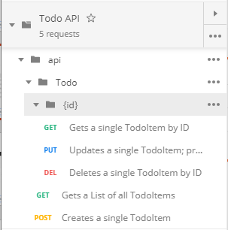
Checking Out Requests
Check out each request
Methods
URL
Headers
Params
Request Body
Notes:
When it imported from Swagger, it didn’t fill everything in for us, so we need to do a bit of cleanup.
But first, let’s check out the requests themselves
Look at Methods, URL, Headers (quickly explain what they mean), Params, Request Body (and how choosing the diff types in Request Body will change headers)
Auth of course – we’re not using any auth on this one but you can see it supports many options
Pre-request scripts
And you can write tests here in Javascript. Those tests can be put into your CI/CD pipeline with Newman if you like.
We won’t be using this feature today, unfortunately, but there’s a lot of documentation online to get you into it.

Slide 54
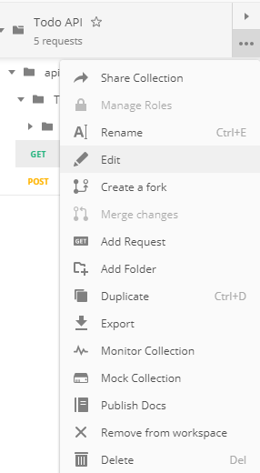
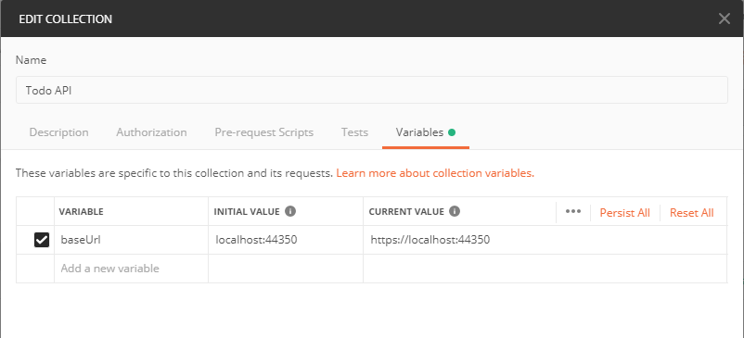
Adjusting Variables
Notes:
We’ll need to adjust the variable it automatically puts in here for us to be the right URL.
Postman has variables at the Collection level, as well as things called Environments that you can set to make testing across development environments easier

Slide 55
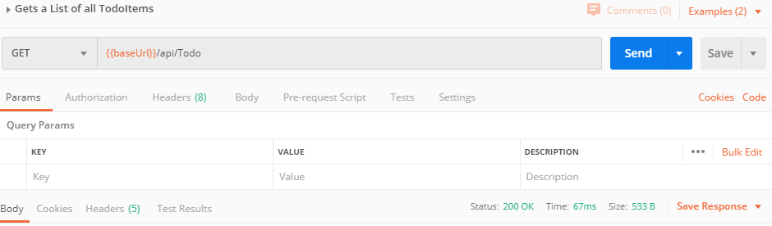
Making Requests
Notes:
Open the first GET request in the list, the one that gets a list of all todoitems
let’s test this one out! Go ahead and hit Send
After you hit send you should see all of the Todo items we see in the UI

Slide 56
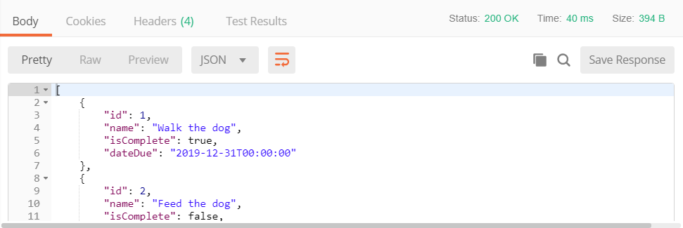
Making Requests
Notes:
And you should get a 200 OK now, and get values back of our TODO items

Slide 57
Making Requests
Look back at our GET request
Response Body
Headers
Status Code
Time
Notes:
Now lets actually look at what happened when we made that GET request earlier
Look at the response body – these are all of our to-do items right now
The headers of the response
Cookies if there were any
The status code is clear right here, and has an explanation if we need more info
It also shows the time – how long the request took round-trip

Slide 58
Translating UI Tests to API Tests

Slide 59
What Types of Tests Can We Perform?
Smoke tests
CRUD
Boundary
Required Fields
Field Type
Error Conditions
Security
Performance/load/stress
Usability
Localization
Consumer-Driven Contract
Many more!
Notes:
Remember the types of tests we can perform on an API that we looked at earlier? Let’s try some of those tests now

Slide 60
Security Tests - XSS
UI
Enter name w/ XSS and submit => successful, bad chars stripped
API
Make request with name w/ XSS => 200 OK, bad chars stripped
Make request with name w/ XSS, check how UI responds
API + UI
Notes:
Let’s look at an example of security tests, such as Cross Site Scripting. We think of that as something you can only do in the UI, but that’s not the case!
With the UI, we might enter a name w/ XSS and submit, and see what it looks like – we should potentially see a new item created with the bad characters stripped
With the API we might make a request with a name w/ XSS and get a 200 ok with the bad characters stripped out
If we’re testing across the stacks, we might make that request in the API and see how the API responds, then check how the UI looks and make sure they’re in line
Doing security tests in both the UI and API helps us see where the validation checks are happening – is it just in the javascript? Or are we validating data at the API level as well?

Slide 61
Demo
Translating UI tests to API tests
XSS
Required fields
Boundary
Audience suggestions!
Notes:
Let’s try that XSS test live, and see how we do. Then we can try a few others
Take suggestions from audience maybe?
How would we do the test in the UI?
Now how would we do that using Postman?
Request
Response
What we should have expected for this scenario

Slide 62
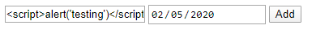
XSS Testing Example
Add a new item in the UI
<script>alert('testing')</script>
Notes:
We should see our new item added, but no popup alert on the page

Slide 63
XSS Testing Example
Do a POST request with XSS -> 201 Created
{"name": "<script>alert('oh no!')</script>"}
Notes:
We should get a 201
We can see in the response, though, none of the bad characters are escaped. This isn’t looking good.

Slide 64
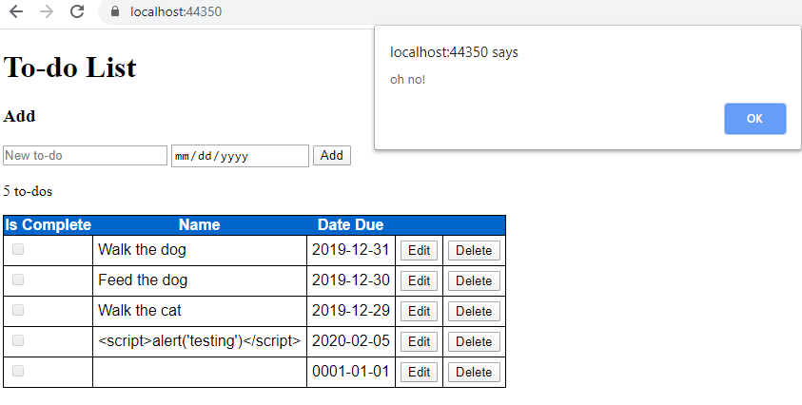
XSS Testing Example
Check the UI
Notes:
When we check the UI we can see that – yep – that cross site scripting got through!

Slide 65
Test Across the Stack!

Slide 66
Why Test Across the Stack?
Different code (possibly) written by different people
We need both front-end and back-end data validation!
Different types of users
Different uses
Think towards the future
Notes:
* Each layer of our application has been written by a number of different people, and people make assumptions about how other people do things and how the application will be used. As we’ve seen, that can lead to some security issues if not others
* We need to test both sides because both have different types of users and different uses, and as we saw, we need to handle data validation across the stacks
* Think about the future with API use especially – what if you decide to develop this into an app for a watch for instance? You’re not going to write a new API, just the UI that consumes it. So that API should be able to handle whatever you throw at it from whatever source.

Slide 67
Improve Your Testing Across the Stack
Learn about the API
With documentation
From the code
With Dev Tools in the browser
Give the API some testing love
Alone
And with a friend (the UI)!

Slide 68
Resources
https://github.com/g33klady/TodoApiSample
Links
Slides
TodoAPI App

